Slide 1
EE 4130 – Systems Engineering –
The Problem Statement
Prof. Joel Harris
29 January 2018

Slide 2

The Problem Statement
A problem statement has the following attributes:
  It is [relatively] non-technical
  Uses the “language of the customer”
  It is kept straightforward – non complex

Slide 3
Some techniques for arriving at a well made problem statement..
  Question the customer
  Differentiate their needs and wants
  Explore project boundaries
  Do an input/output analysis
  Preview the user interface
  Survey the design attributes
  Identify conflicting needs
  Prepare a draft operations manual

Slide 4
Sections of the Problem Statement
  Background/Overview
  The overall design [non detailed]
  Deliverables of the design project

Slide 5
Examples of Good Problem Statements
“People need cheaper and better-performing car radios, because current radios are expensive and poor at picking up weak radio signals”
“Professors need a better way to erase whiteboards, because they are messy and it’s hard remove all of the marks.”
“Students need an easier way to lock their lockers at school, because combination locks are hard to unlock and often get jammed.”

Slide 6
Key elements of problem statements
Define the actual problem at hand
  Ask what is the need/problem?
  Determine who has the need?
  Establish why is this important?
In other words, from a design POV, you are defining:
  The user (who)
  The need (what)
  The why (insight)

Slide 7
Other Characteristics of Good Problem Statements
Short/terse/to the point.
Avoids defining a specific problem solution
Is not a short list of requirements
Captures the essence of the problem/need at hand
Should include qualitative and quantitative terms

Slide 8
Practice Problem Statement
Class Exercise:
Write a problem statement about the need for
more student parking capacity at CSULA…

Slide 9
Needs Analysis
Translating a “want” into a more specific system requirement from a functional point of view…
  When should this be done by?
  What should the system be able to do?
  What are the primary and secondary functions?
  Where will this system accomplish these functions?
  How often will the system function/operate?

Slide 10
Operational Requirements
Mission definition or statement
Environmental factors (operating conditions)
Operational lifetime/deployment
Utilization requirements (frequency of use, hours of operation, capacity)
Performance parameters (mass, volume, range, velocity, etc.)
Effectiveness (MTBM, MDT, MTBF)

Slide 11
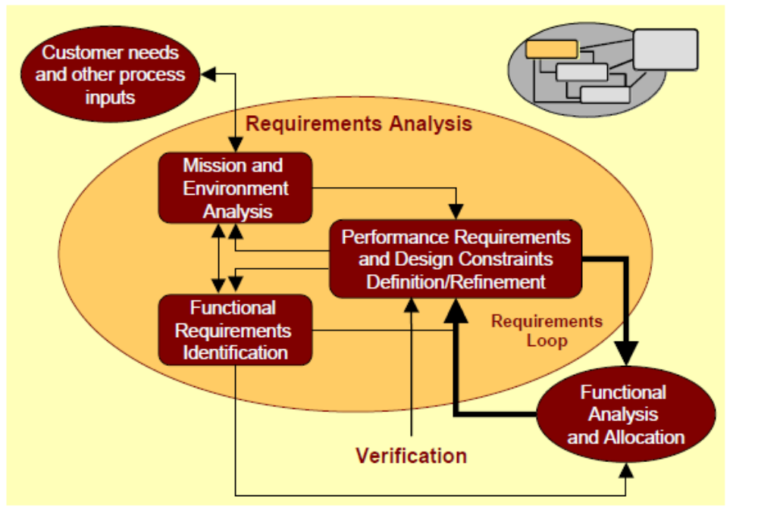
Requirements Analysis Process

Slide 12
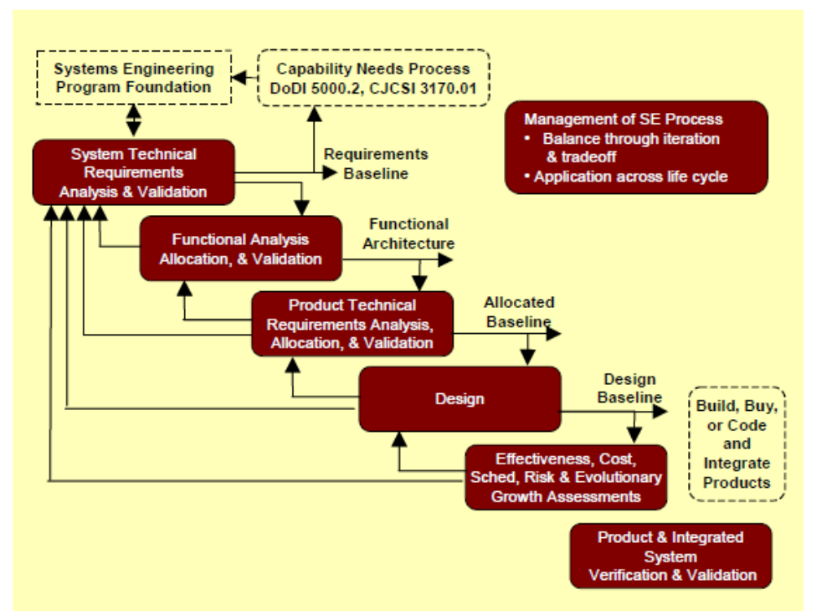
Overall Systems Engineer Process Flow Diagram

